Slide 1
Basic Routing
Gateway Operations

Slide 2
Static Routing
Static routing is when you statically configure a router to send traffic for particular destinations in preconfigured directions.
AD Value : 1
Advantage :
Static routing causes very little load on the CPU of the router, and produces no traffic to other routers.
Static routing leaves the network administrator with full control over the routing behavior of the network.
Disadvantage :
Human error: In many cases, static routes are manually configured. This increases the potential for input mistakes. Administrators can make mistakes and mistype in network information, or configure incorrect routing paths by mistake.
Fault tolerance: Static routing is not fault tolerant. This means that when there is a change in the network or a failure occurs between two statically defined devices, traffic will not be re-routed. As a result, the network is unusable until the failure is repaired or the static route is manually reconfigured by an administrator.

Slide 3
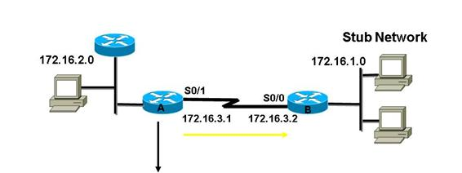
Static Routing
IOS XE : (Router A)
conf t
ip route 172.16.1.0 255.255.255.0 172.16.3.2
end
IOS XR : (Router A)
conf t
router static
address-family ipv4 unicast
172.16.1.0/24 172.16.3.2
commit
end

Slide 4
OSPF (Open Shortest Path First)
Open Shortest Path First (OSPF) is a routing protocol for Internet Protocol (IP) networks. It uses a link state routing (LSR) algorithm and falls into the group of interior gateway protocols (IGPs), operating within a single autonomous system (AS).
AD Value : 110

Slide 5
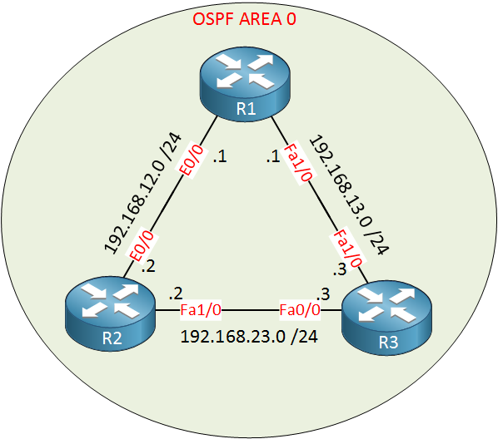
OSPF (Open Shortest Path First)
IOS XE : (Router 1)
conf t
interface e0/0
ip ospf 1 area 0
exit
interface fa1/0
ip ospf 1 area 0
end
IOS XR : (Router 1)
conf t
router ospf 1
area 0
interface fa1/0
interface e0/0
commit
end

Slide 6
BGP (Border Gateway Protocol)
Border Gateway Protocol (BGP) is a standardized exterior gateway protocol designed to exchange routing and reachability information among autonomous systems (AS) on the Internet. The Border Gateway Protocol makes routing decisions based on paths, network policies, or rule-sets configured by a network administrator and is involved in making core routing decisions.
BGP may be used for routing within an autonomous system. In this application it is referred to as Interior Border Gateway Protocol, Internal BGP, or iBGP. In contrast, the Internet application of the protocol may be referred to as Exterior Border Gateway Protocol, External BGP, or eBGP.
AD Vlaue :
iBGP – 200
eBGP - 20

Slide 7
BGP (Border Gateway Protocol) : iBGP
IOS XR:
conf t
router bgp 58717
neighbor 103.15.244.5
remote-as 58717
description ABC
update-source Loopback0
address-family ipv4 unicast
route-policy ALL-ROUTE out
next-hop-self
soft-reconfiguration inbound always
commit
end
IOS XE :
conf t
router bgp 58717
neighbor 103.15.244.60 remote-as 58717
neighbor 103.15.244.60 description ABC
neighbor 103.15.244.60 update-source Loopback0
neighbor 103.15.244.60 activate
neighbor 103.15.244.60 send-community
neighbor 103.15.244.60 next-hop-self
end

Slide 8
BGP (Border Gateway Protocol): eBGP
IOS XR:
conf t
router bgp 58717
neighbor 163.47.80.77
remote-as 132602
description @@ BSCCL-COX-EBGP @@
address-family ipv4 unicast
route-policy BSCCL-COX-IN in
route-policy BSCCL-COX-OUT out
remove-private-AS
soft-reconfiguration inbound always
commit
end
IOS XE :
conf t
neighbor 180.87.37.17 remote-as 6453
neighbor 180.87.37.17 description @@ TATA-CHN-6-EBGP @@
neighbor 180.87.37.17 activate
neighbor 180.87.37.17 send-community
neighbor 180.87.37.17 remove-private-as
neighbor 180.87.37.17 route-map TATA-CHN-6-IN in
neighbor 180.87.37.17 route-map TATA-CHN-6-OUT out
end

