Slide 1
ISP IPv6 Address Planning Structure

Slide 4
ISP IPv6 Address Planning Structure

Slide 5
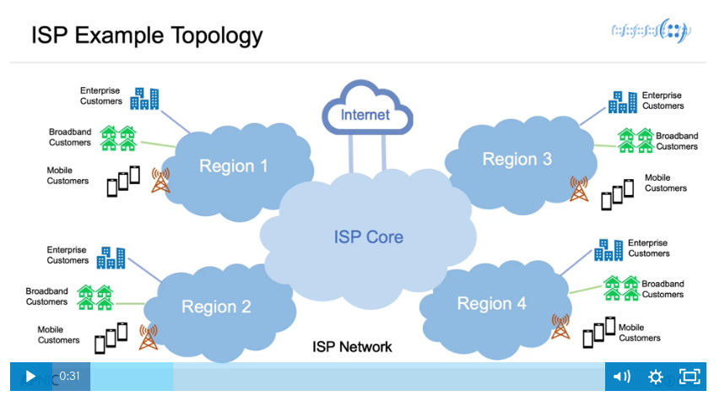
ISP IPv6 Address Planning Structure

Slide 6
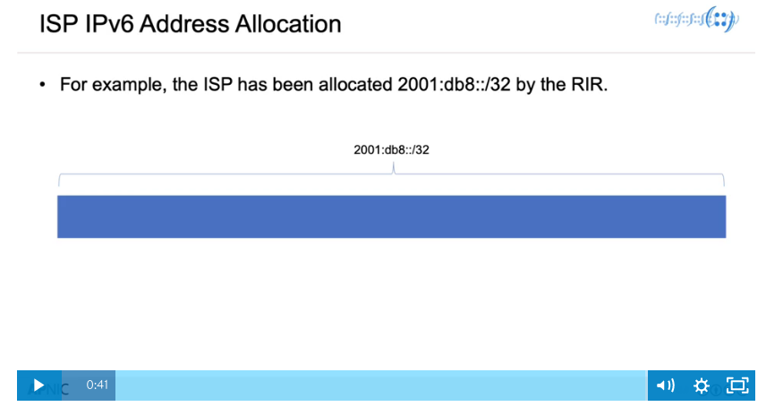

Slide 8
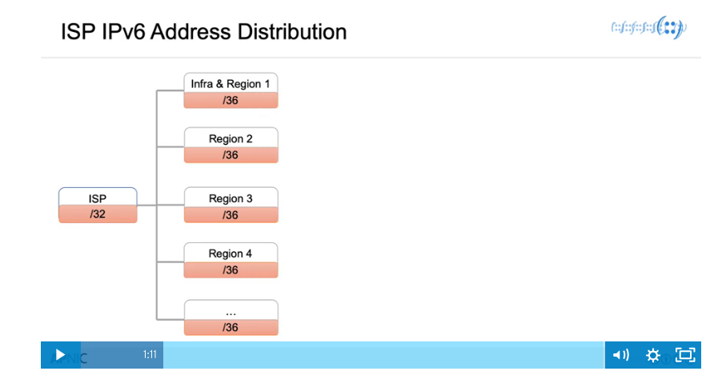

Slide 10
ISP IPv6 Address Planning Structure

Slide 11
ISP IPv6 Address Planning Structure

Slide 12
ISP IPv6 Address Planning Structure

Slide 15
