Slide 1
Summit Communications Ltd.
ITC Overview
Date- 7th November’21

Slide 2
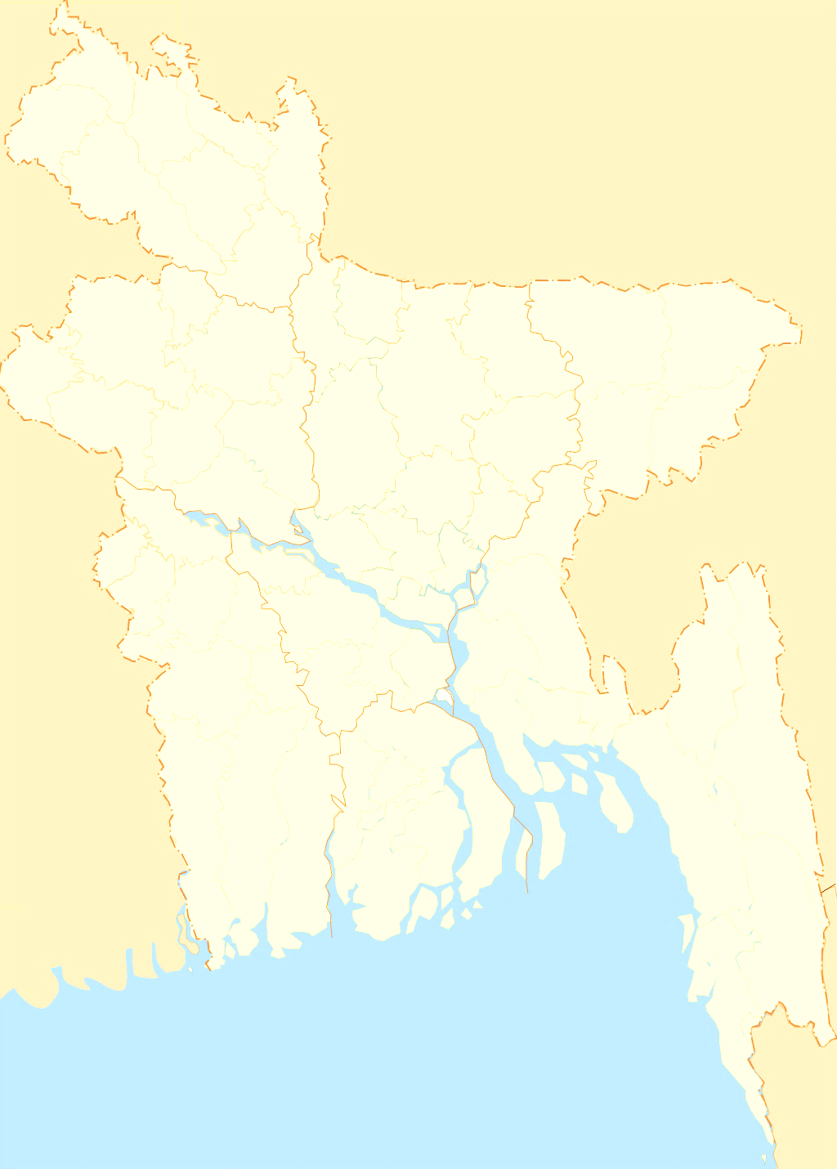
How Bangladesh is connected to the rest of the world
International Gateways of Bangladesh
Gateway(s) | Capacity (Gbps)
SMW4 | 500
SMW5 | 1300
ITC | 1200
Total Country | 3000
ITC
Benapole
ITC is serving 36% BW of total country..
SMW5
SMW4

Slide 3
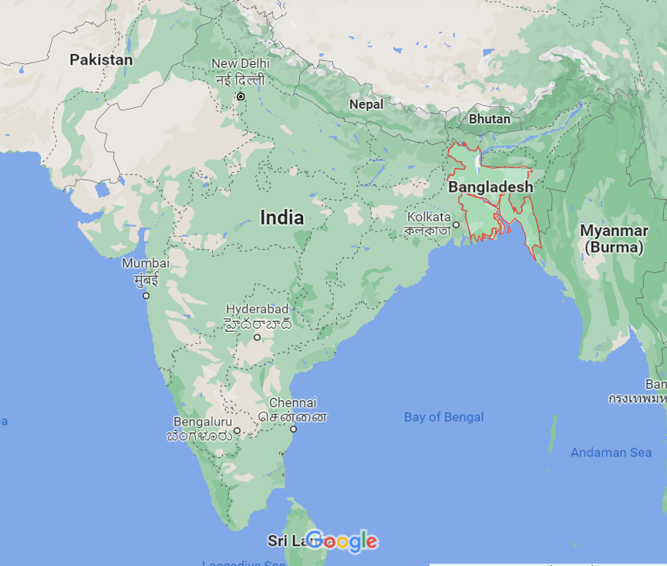
Where we go in India…
Mumbai
Gateway to West/Europe
Submarine Cable System:
IMEWE
TGN
AAE1
EIG
Delhi
Kolkata
IMEWE
Mumbai
TGN
Location | Who are there…
Kolkata | Facebook
Delhi | Google
Mumbai | Google, Facebook
Chennai | Google, Facebook
Chennai
EIG
Gateway to East/Singapore
Submarine Cable System:
TIC
I2I
BBG
SMW4
AAE-1
Chennai
TIC
I2I
BBG
SMW4

Slide 4
INDIA
Tata POP
Airtel POP
No Man’s Land
Tata HH-1
Tata HH-2
Airtel HH
BANGLADESH
SComm HH-1
SComm HH-2
SComm ITC
HH
HH

Slide 5
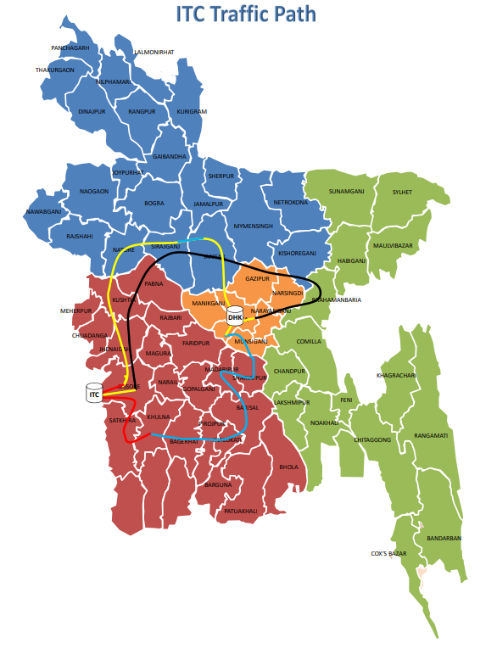
Dhaka-Benapole Backbone path Quarterly MTTR:

Slide 6
ITC Device Details:
Device Name | Model No | Quantity
Tejas SDH MUX | 1600 | 2 Pcs
Huawei DWDM MUX | OSN 8800 | 2 Pcs
Device Capacity:
Device Name | Capacity
Tejas-1600 | 320Gbps Each
Huawei OSN 8800 | 800Gbps Each

Slide 7
Number of core in pair with TATA and Airtel:
 | TATA | AIRTEL
SDH | 8 | 22
DWDM | 2 | 2
Total | 10 | 24
Used Fiber | 10 | 12
Tested Fiber | 0 | 12
Maximum Expandable Capacity with TATA and Airtel:
 | TATA(Gbps) | AIRTEL(Gbps)
SDH | 50 | 100.62
DWDM | 400 | 400
Total | 450 | 500.62

Slide 8
Upstream Capacity with TATA and Bharti:
Upstream Name | Capacity(Gbps)
TATA | 365.230
Bharti Airtel | 315.190
Total | 680.420
Downstream Capacity Breakdown:
Client Name | Capacity(Gbps)
Scomm IIG | 454
Other IIG | 217.45
Corporate IPLC | 0.25
IGW | 1.085
Total | 672.785

Slide 9
Other IIG Client BW Information:
Client Name | Capacity(Gbps)
Aamra Technologies Ltd. | 70
Earth Telecommunication (Pvt.) Limited | 80
Windstream Communication Ltd. | 50
bdHUB Limited | 7.5
Apple Communication Limited | 4
Optimax Communication Ltd. | 4
Virgo Communication Ltd | 1
SkyTel Communications Ltd | 0.93
Toron Limited | 0.02

Slide 10
Tejas-1600 MUX card count:
Card Name | Quantity
HCPSLine03 | 12
HCPSLine01 | 4
HCPULine01 | 2
HCPXCC03 | 4

Slide 11
Huawei OSN 8800 card count:
Optical Sub-rack Card Name | Quantity
M40V | 4
D40 | 4
OAU | 8
EFI | 2
SCC | 2
STG | 2
Electrical Sub-rack Card Name | Quantity
NS4 | 8
TTX | 7
TSC | 1
QCP | 2
UXCM | 4

Slide 12
Network Diagram:
Tata POP
Airtel POP
INDIA
Bongaon
Tata HH-2
No Mans Land
Tata HH-1
Airtel HH
Benapole
SComm Immigration HH
BANGLADESH
SComm BGB HH
ROAD
HH
Scomm ITC POP
NTTN TX
Scomm ITC Dhaka POP
HH

